Slide 1
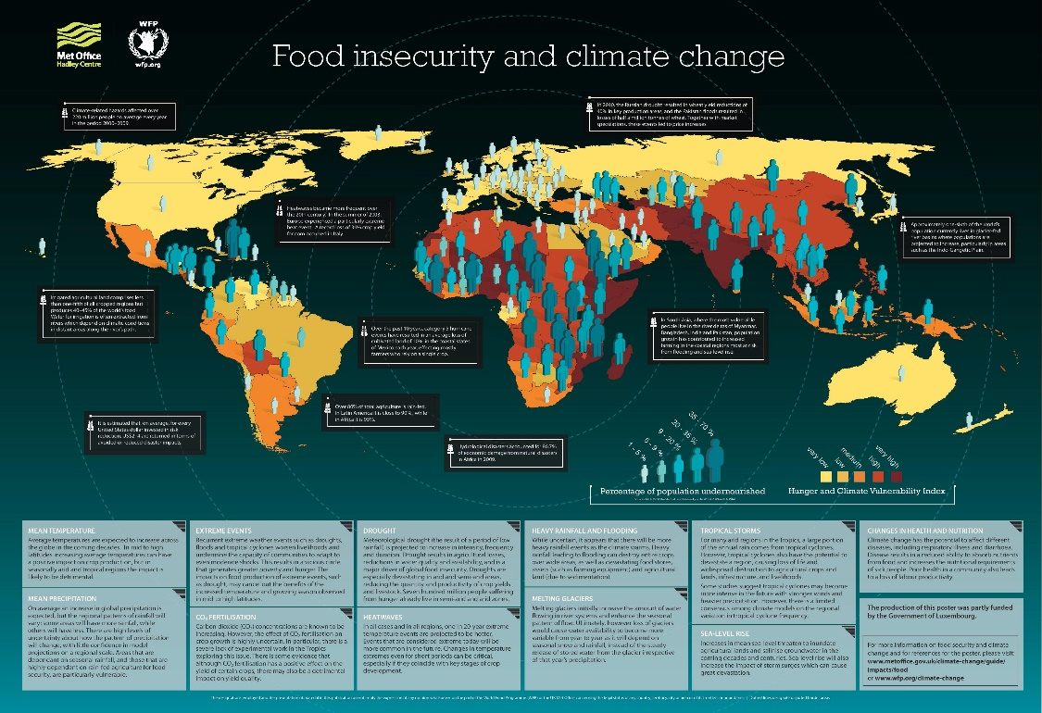
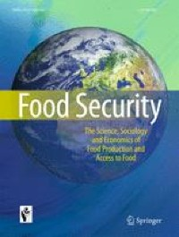
The Impact of
Climate Change
on Global Food Security
Presented by
GROUP 3
Course
Btech CSE F1
Date
30-10-2025

Slide 2
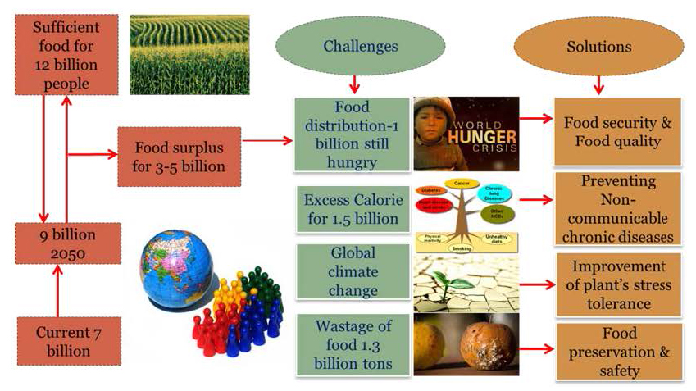
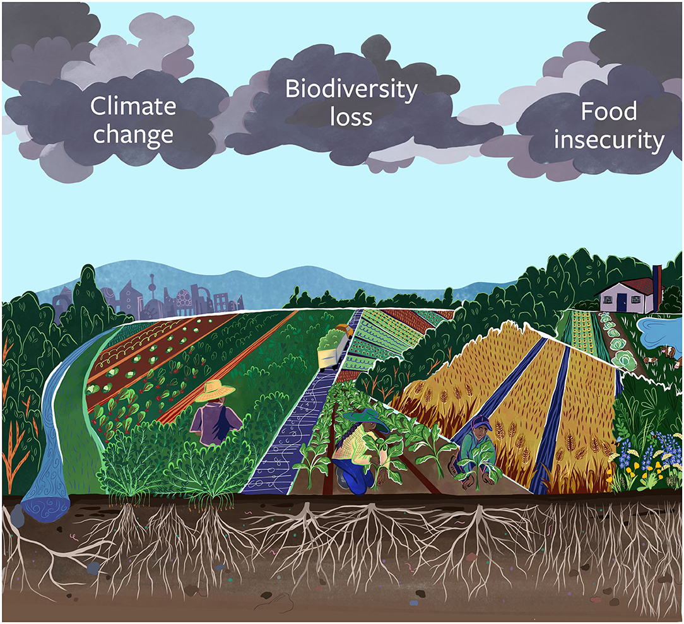
Introduction
Climate change refers to long-term shifts in temperature and weather patterns.
Global food security means having access to enough safe and nutritious food for all people.
Climate change is now one of the biggest threats to food security worldwide.

Slide 3
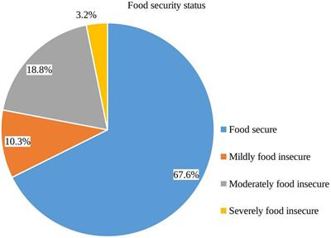
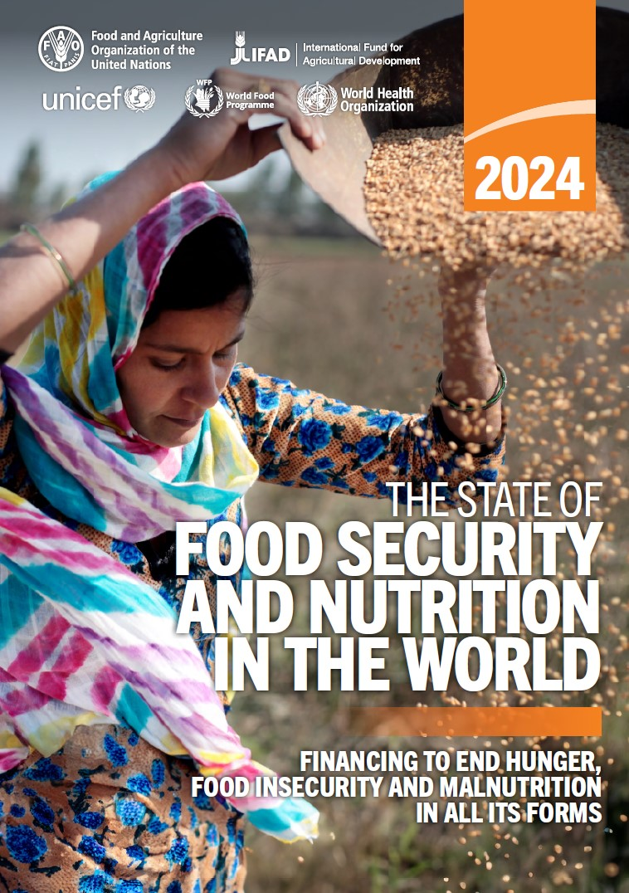
What is
Global Food Security?
Food security is based on four main pillars:
Availability – Is food produced in enough quantity?
Access – Can people afford to buy food?
Utilization – Is the food nutritious and safe?
Stability – Will food be available consistently over time?

Slide 4
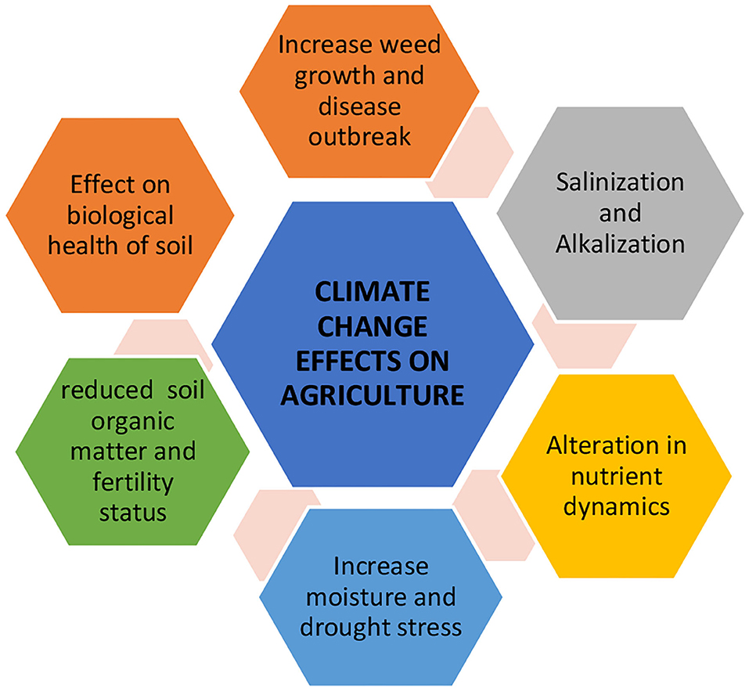
How Climate Change Affects Food Production
Rising temperatures reduce crop yields like wheat and rice.
Changes in rainfall patterns cause droughts or floods.
Extreme weather destroys crops and farmlands.
Increase in pests and diseases.

Slide 5
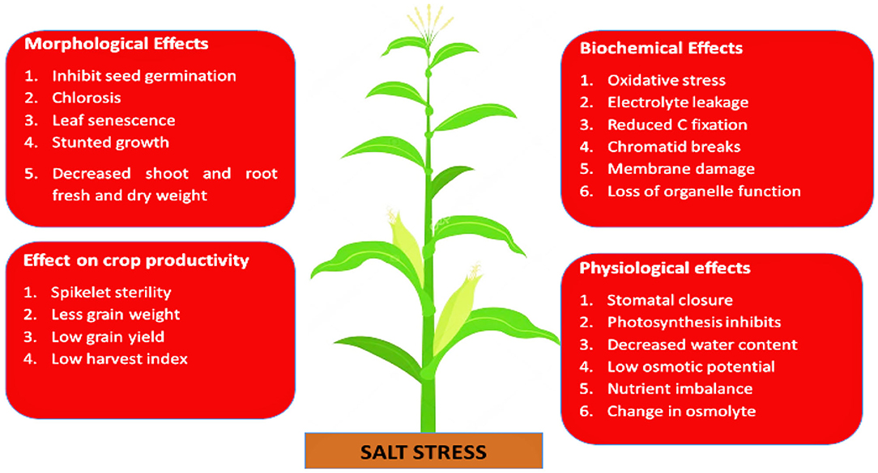
Effects on Major Crops
Crop Impact of Climate Change
Wheat Reduced yield due to heat stress
Rice Flooding affects paddy fields
Maize Drought conditions reduce production
Soybean Sensitive to changes in temperature

Slide 6
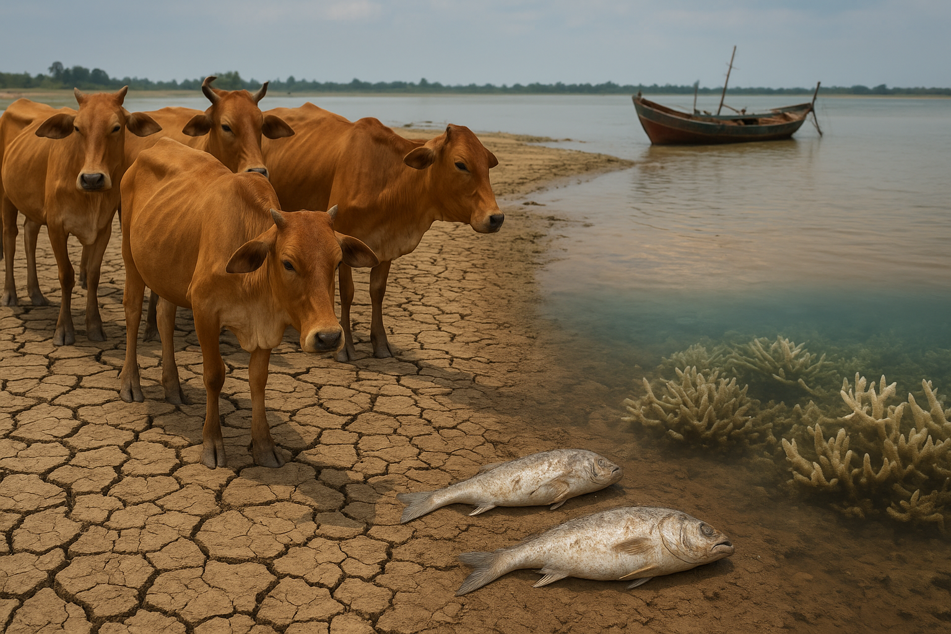
Impact on Livestock and Fisheries
Heat stress reduces animal growth and milk production.
Water scarcity affects livestock health.
Oceans are warming, reducing fish population.
Coral reefs are dying, affecting marine food chains.

Slide 7
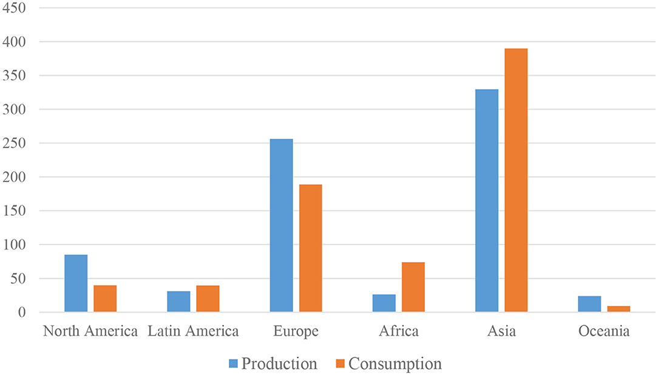
Rising Food Prices
Lower production = higher prices.
Poor and developing countries are most affected.
Food shortages can lead to economic instability and hunger.

Slide 8
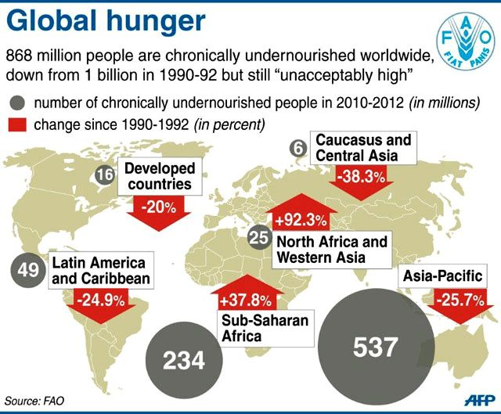
Global Hunger and Malnutrition
Climate change threatens the goal of zero hunger (UN SDG 2).
345 million people face high levels of food insecurity.
Malnutrition increases due to lack of nutritious food.

Slide 9
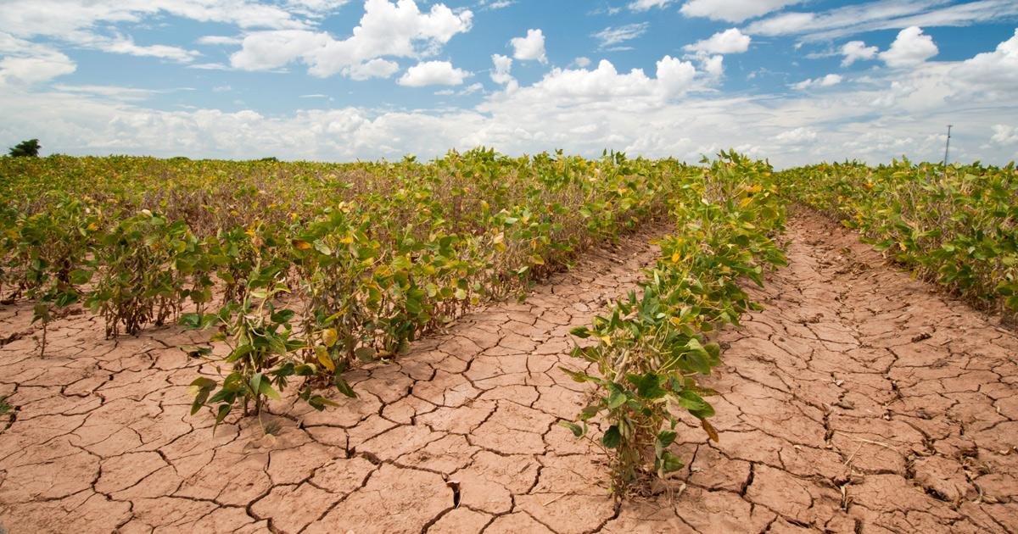
Climate Change and Farmers
Small farmers are the most vulnerable.
Crop failure leads to loss of income.
Migration from rural to urban areas increases.

Slide 10
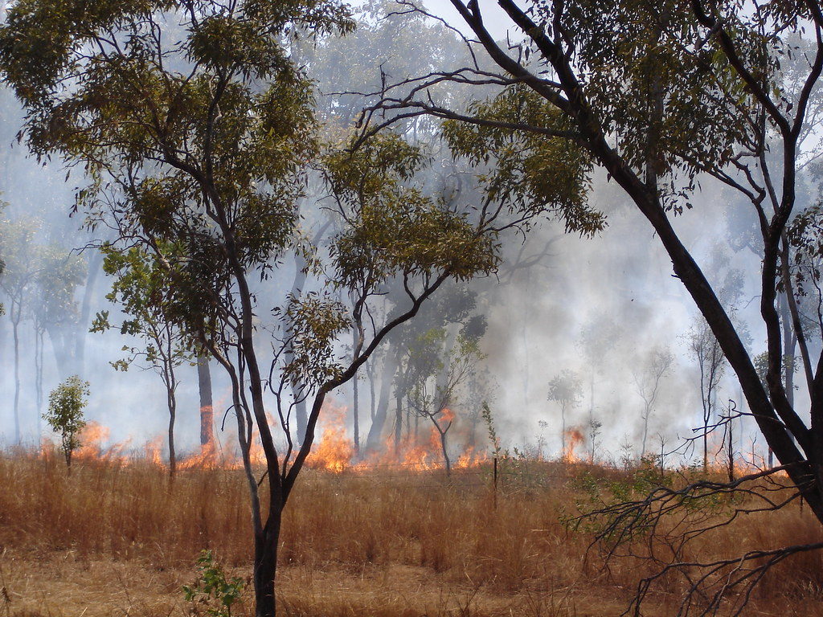
Case Studies
Africa: Severe droughts have led to famine.
India: Unpredictable monsoon affects rice and wheat production.
Australia: Bushfires affect farmland and livestock.

Slide 11
Solutions to Combat Food Insecurity
Climate-smart agriculture (CSA)
Drought-resistant and flood-resistant crops
Efficient irrigation systems
Crop diversification
Early warning systems for extreme weather

Slide 12
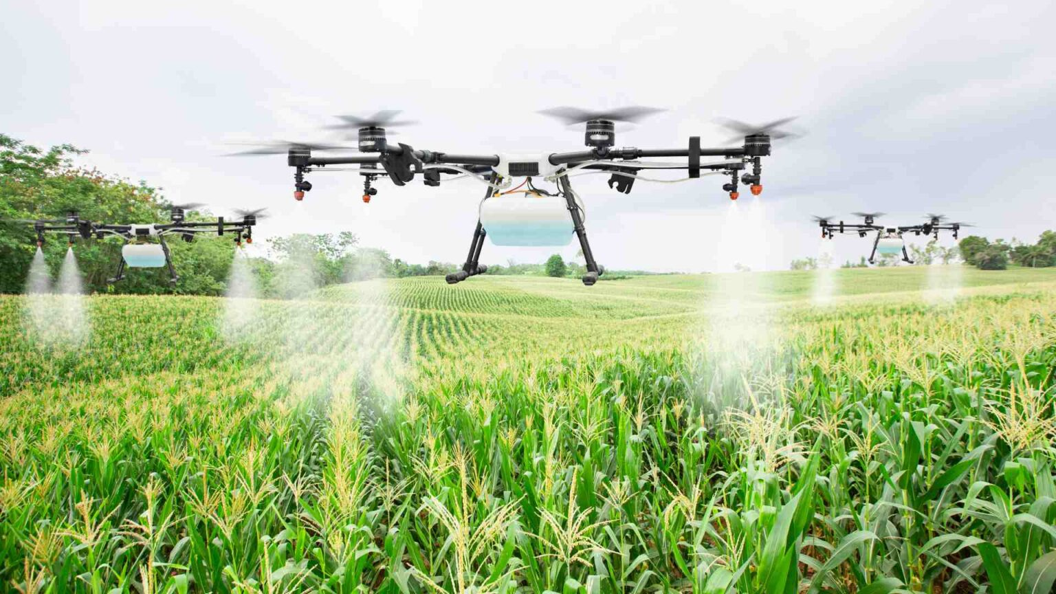
Role of Technology
Use of drones and sensors in farming
Weather forecasting tools
Development of climate-resilient seeds
Vertical and indoor farming techniques

Slide 13
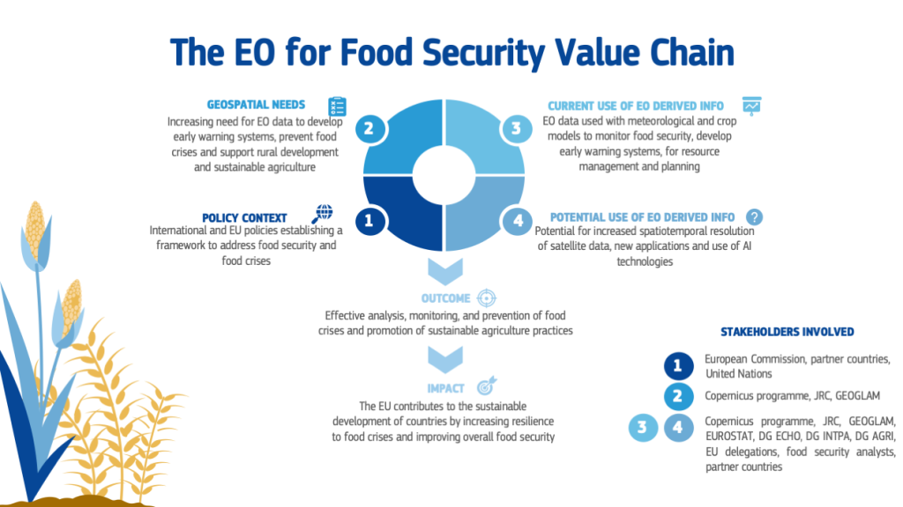
International Efforts
Paris Agreement: Limit global warming to below 2°C.
FAO & UN Programs: Support sustainable agriculture.
SDG Goal 2: End hunger by 2030.

Slide 14
What Can We Do?
Reduce food waste.
Promote sustainable farming practices.
Support local agriculture.
Raise awareness about climate change effects.

Slide 15
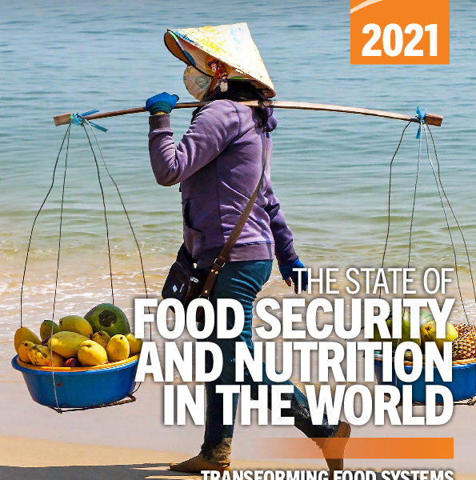
Conclusion
Climate change is not only an environmental issue but a global food crisis.
Immediate action is necessary to secure future food systems.
Sustainable practices and technology are key to overcoming this challenge.

